Slide 1

Node.js: a little overview
Nicola Del Gobbo

Slide 2



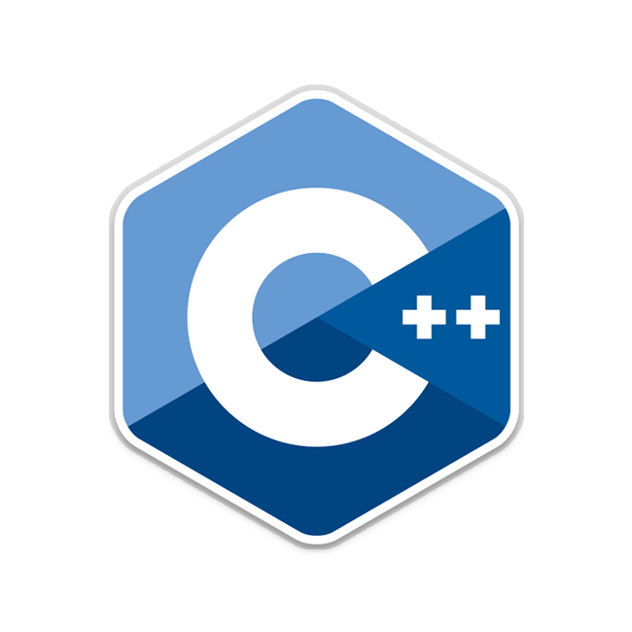


Who am I?
Developer
Full stack developer highly focused on performance
N-API Team
My research field
How to implement a native addon for Node.js with programming languages different from C or C++

Slide 3




Agenda
Introduction to Node.js
How to create distributed services
Native Addons

Slide 4









Who use Node.js?
Notes:
Update the numbers

Slide 5

What can I do with Node.js?
Everything
Great thank to Node.js Community and Working Groups
Packages
963,619
Downloads - Last Week
10,822,198,617
Downloads - Last Month
48,577,378,041
Notes:
Update the numbers

Slide 6









What can I do with Node.js?
CLI APPLICATION
DISRTRUBUTED SYSTEM
REAL TIME SYSTEM
DESKTOP APPLICATION

Slide 7
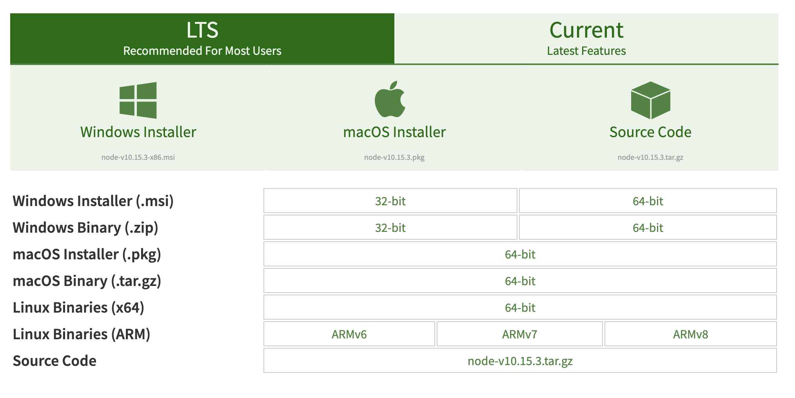
Release

Slide 8
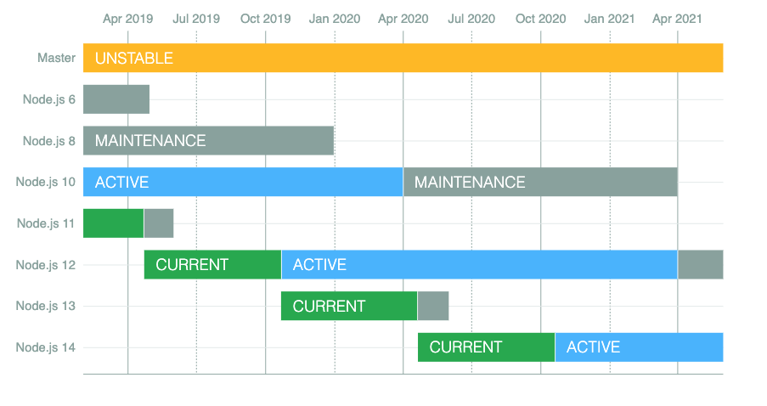
Release
https://github.com/nodejs/Release

Slide 9

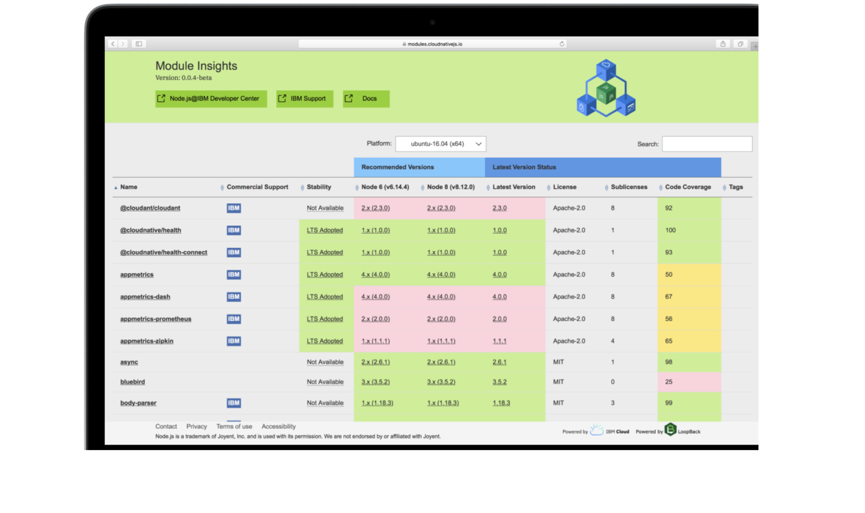





Choose your modules
Add health checking
Track your requests
Power your metrics
Build your Docker image
Deploy to Kubernetes

Slide 10
What is Node.js?
Node.js is a JavaScript runtime built on Chrome's V8 JavaScript engine
~100k LOC of JS and C++
A JavaScript engine
Asynchronous I/O
Node is a glue

Slide 11
Node.js architecture

Slide 12
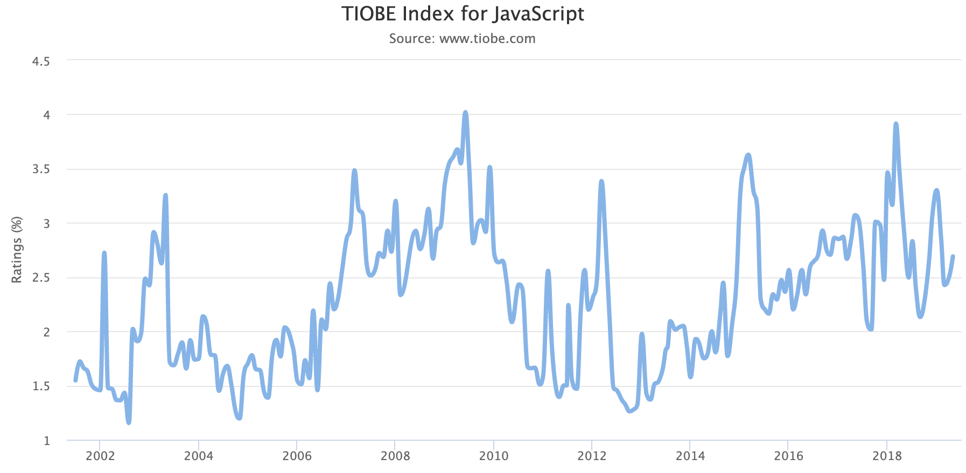
JavaScript
“The world's most misunderstood programming language“
Douglas Crockford

Slide 13
JavaScript
let and const
Better Unicode support
Template literals
Arrow function
Default parameters
Spread operator
Class
Destructuring
Symbols
Sets and Maps
Iterator
Generator
Promise
Async / Await
Async Iterator
Proxy API
Reflection API
ES2015
ES2016
ES2017
ES2018
ES2019

Slide 14

JavaScript
“JavaScript developers should focus on writing idiomatic, readable and maintainable code“
Peter Marshall & Arunesh Chandra
“Use JavaScript like JavaScript“

Slide 15
CONCURRENCY MODEL?
Single threaded
by default
Worker Threads from Node.js v10.5.0
Asynchronous I/O
Execution never stop
Don’t block the event loop

Slide 16
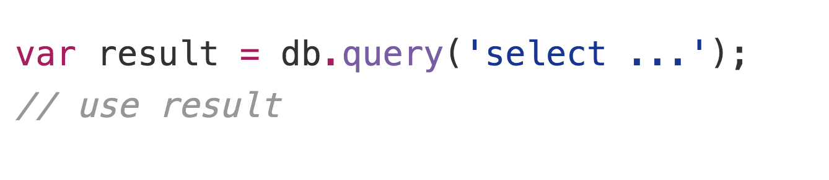
Synchronous model?
Blocking the whole process or you need to have multiple execution stacks

Slide 17
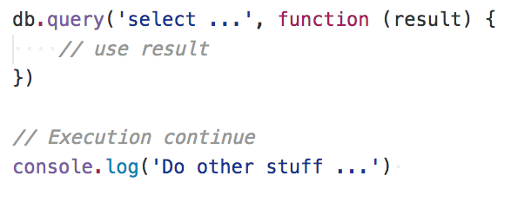
Asynchronous model?
The main process is never blocked. No strategy is required to handle competing requests

Slide 18
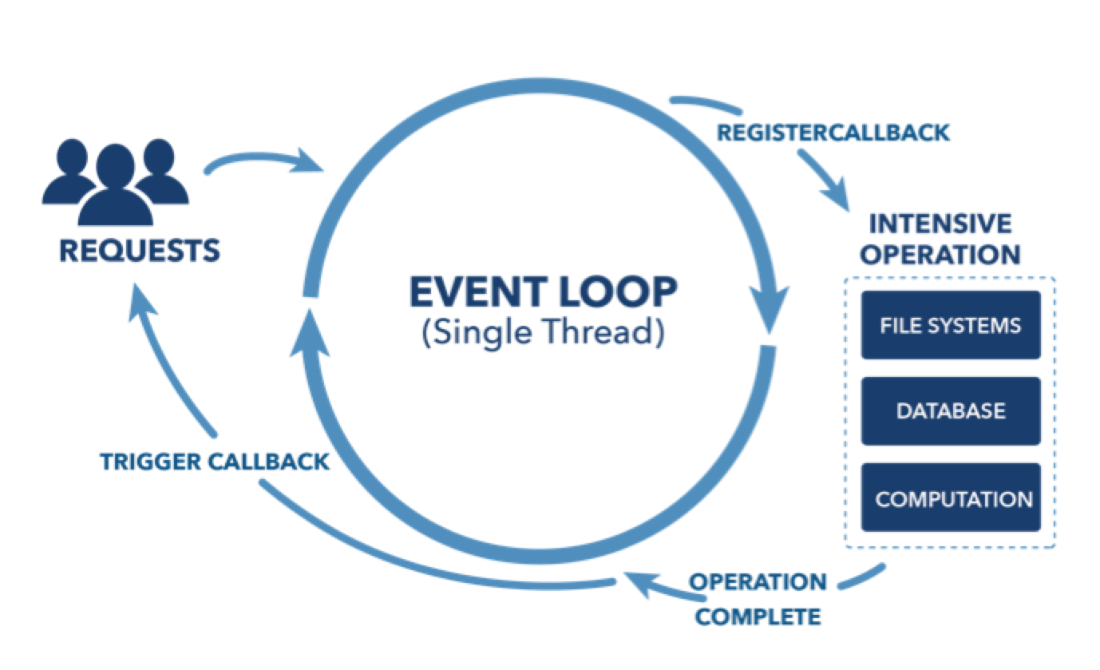
The event loop

Slide 19
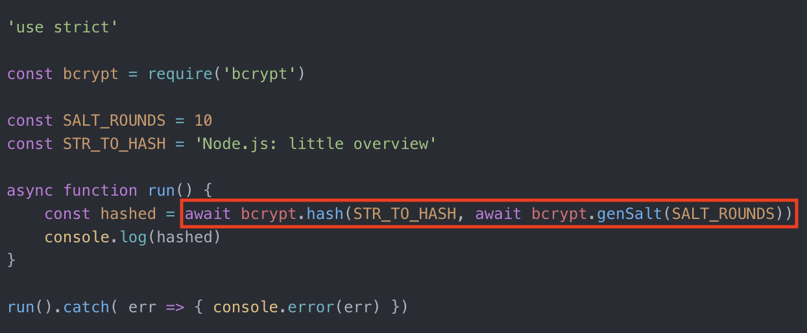
Asynchronous in low level

Slide 20
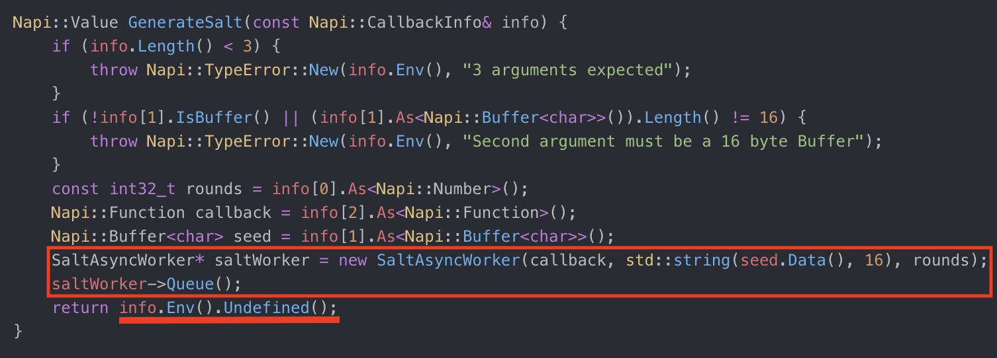
Asynchronous in low level

Slide 21

Modularity
CommonJS Module
ES6 Module from v8.5.0
“Se non hai provato Node.js non sai cos’è la modularità e il riuso”
Matteo Collina

Slide 22
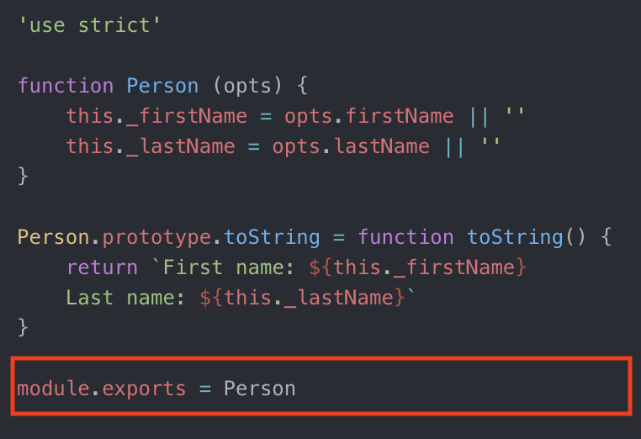
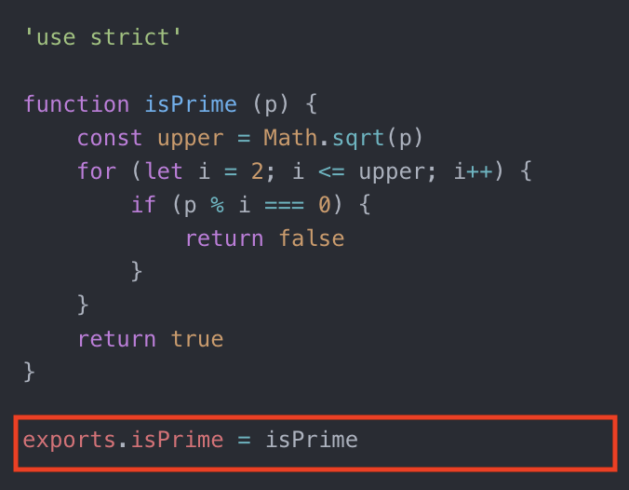
Modularity

Slide 23
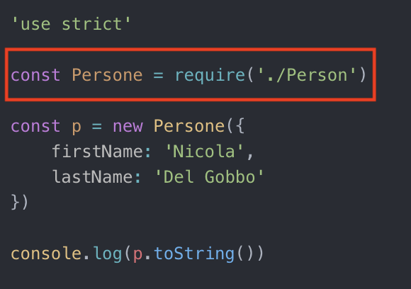
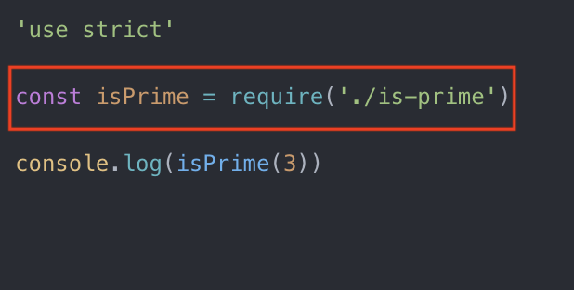
Modularity

Slide 24
Events
EventEmitter is a very important class in Node.js. It provides a channel for events to be dispatched and listeners notified. Many objects you will encounter in Node.js inherit from EventEmitter

Slide 25


Slide 26
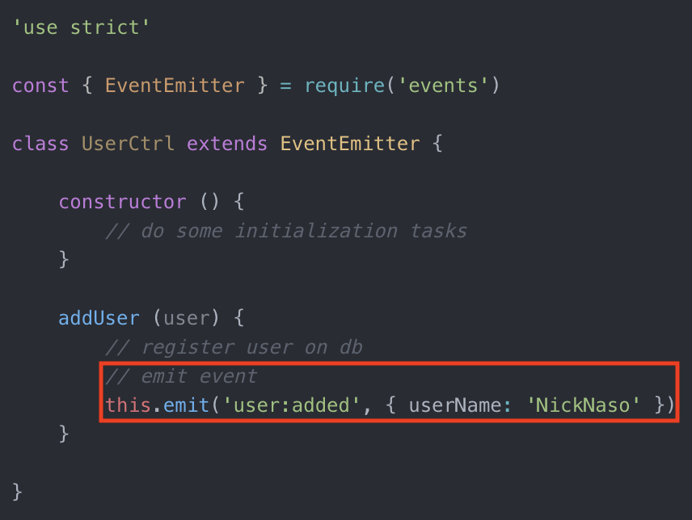
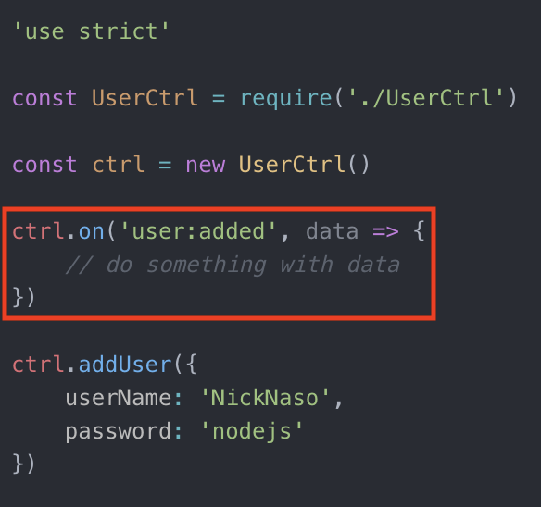
Events

Slide 27
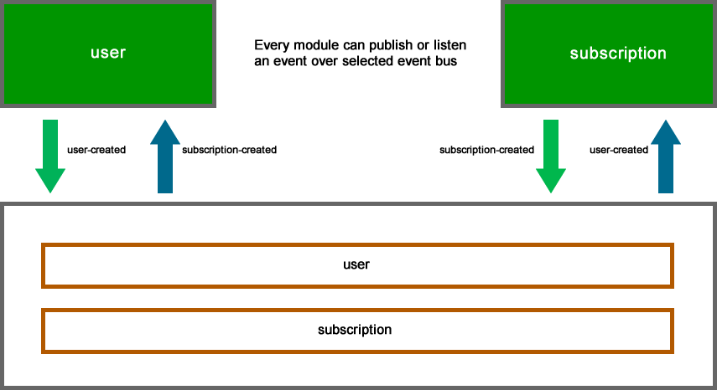
Event bus

Slide 28
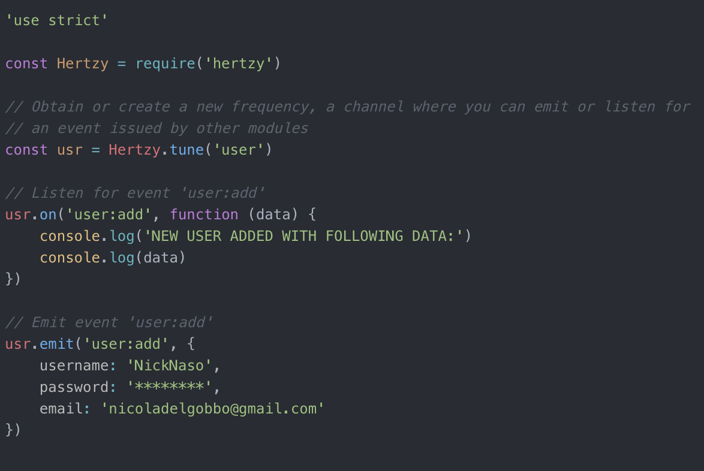
Event bus

Slide 29
Stream
Buffer: data structure to store and transfer arbitrary binary data
Stream: abstract interface for working with streaming data

Slide 30
Stream vs Buffer
Streams keep a low memory footprint even with large amounts of data
Streams allow you to process data as soon as it arrives

Slide 31

Web application
Response
NODEJS HTTP SERVER
REQUEST
HANDLER
CLIENT
Request
Browser
Mobile App
http://your-web-application

Slide 32
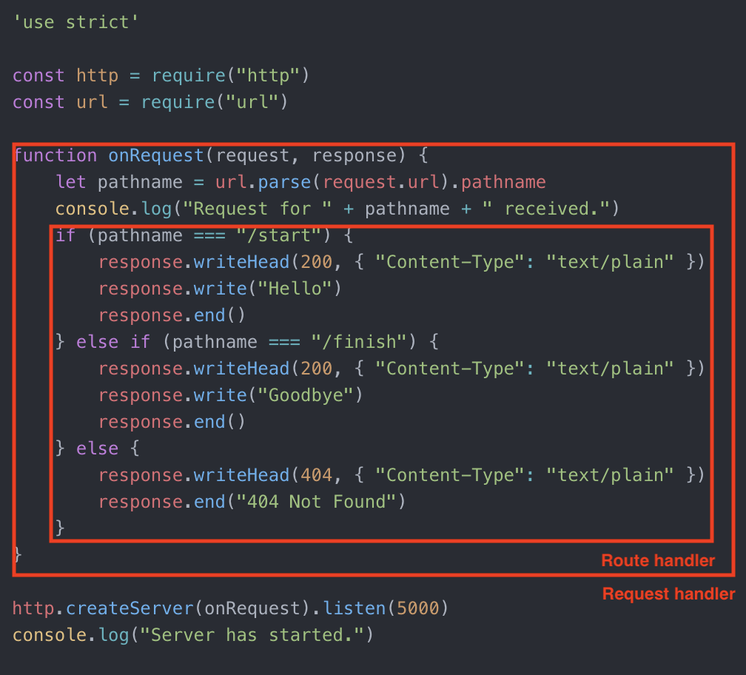
Use http core

Slide 33

Frameworks

Slide 34
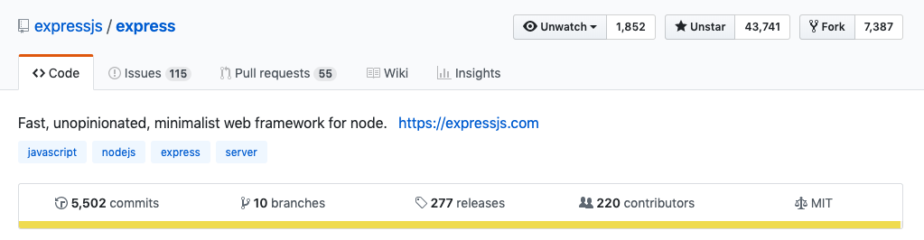

Express
Downloads - Last Week
7,495,349
Downloads - Last Month
33,248,650

Slide 35
Express
Minimalist
Unopinionated
Fast (about 38k req/sec)
Simple (do one thing well philosophy from Unix world)
Wrapper of http core module

Slide 36
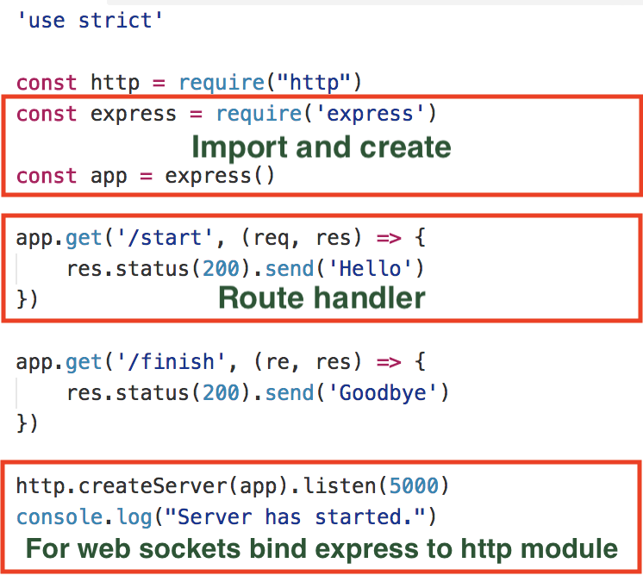

Slide 37
Express milestones
Middleware
Error handler
Router
Views / template engine

Slide 38
Middlewares
It’s always a question to manipulate the Request and Response object

Slide 39
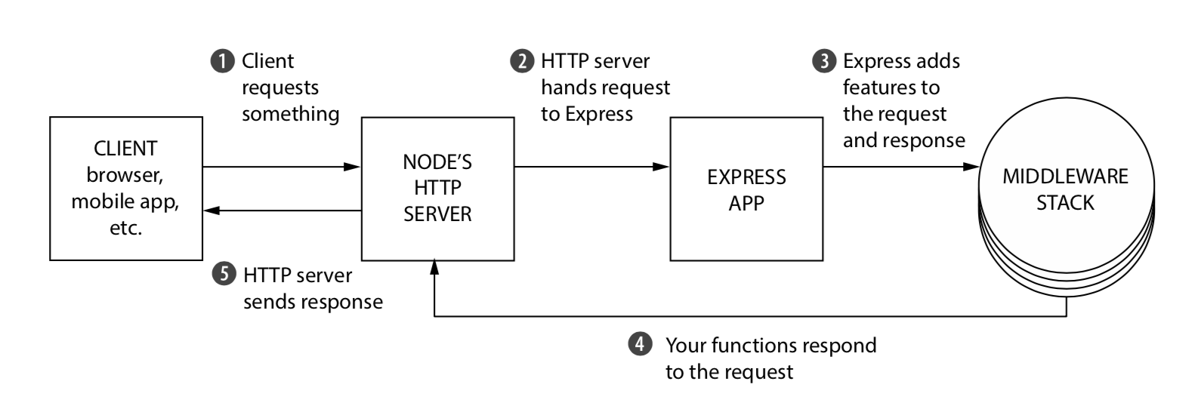
Middlewares

Slide 40
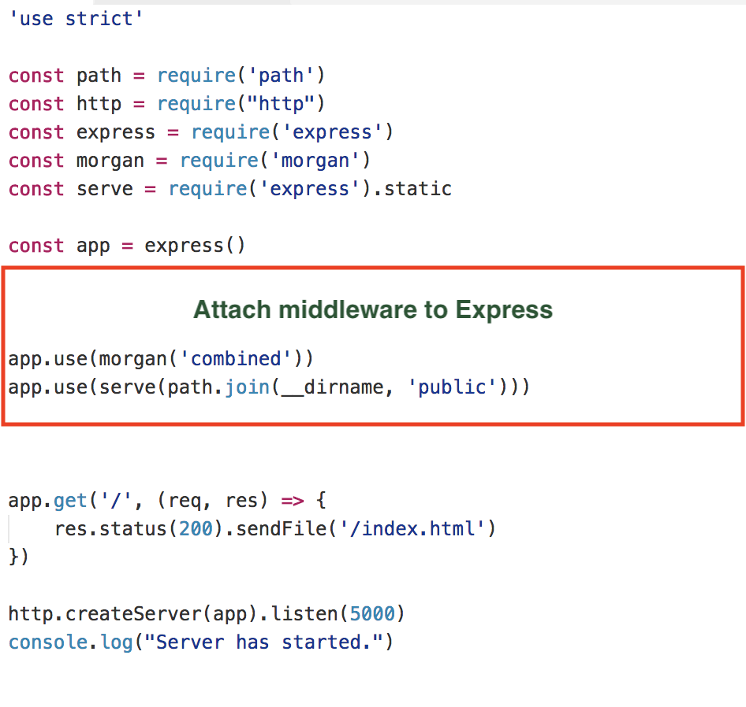
Use middlewares

Slide 41
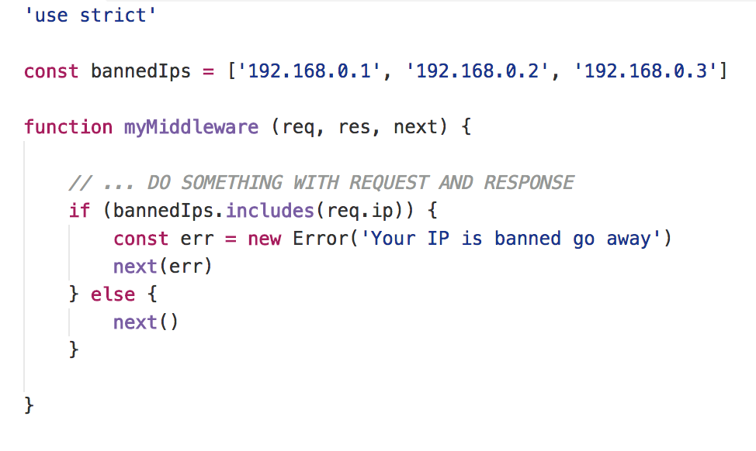
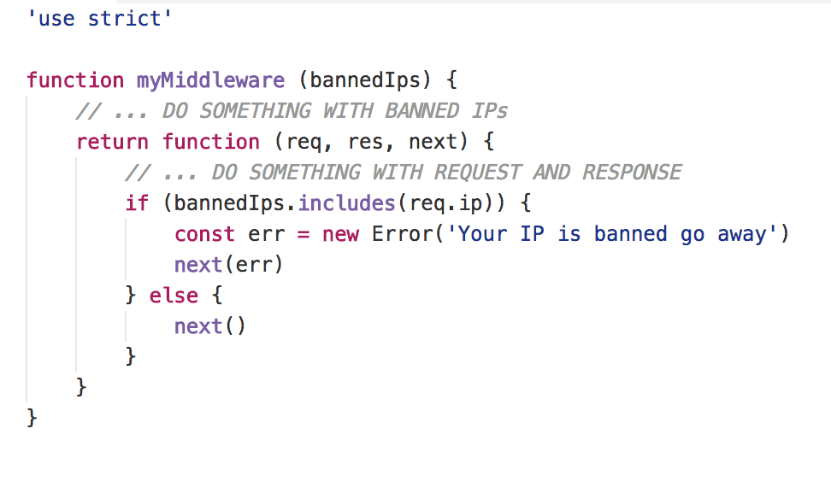
Custom middlewares

Slide 42
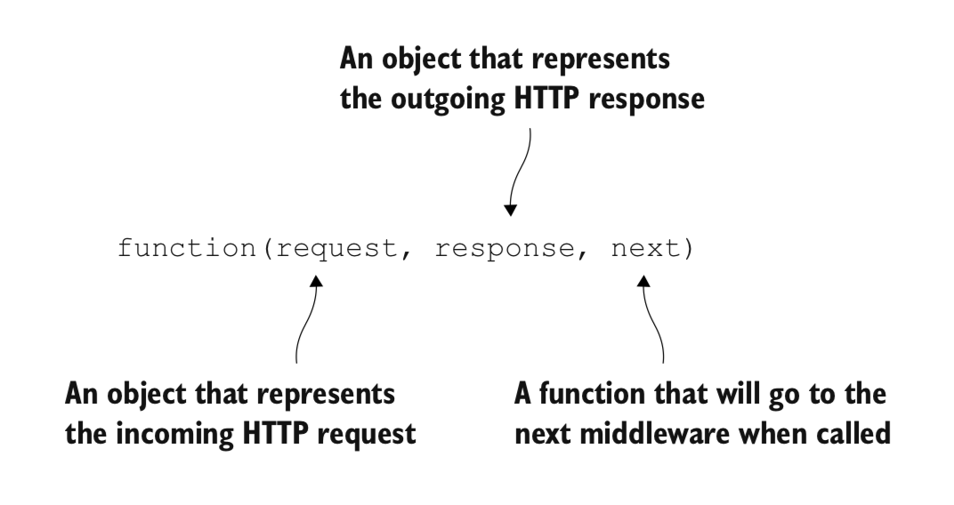
Middlewares
http://expressjs.com/en/resources/middleware.html

Slide 43
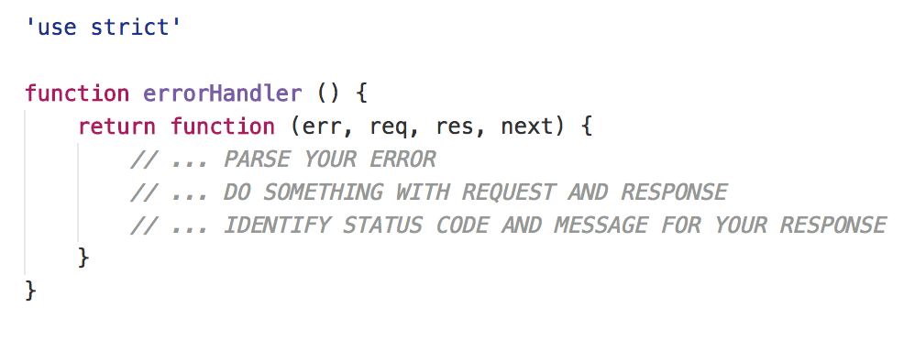
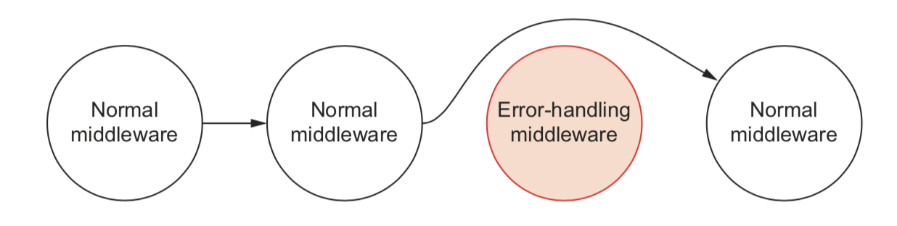
Error handler

Slide 44
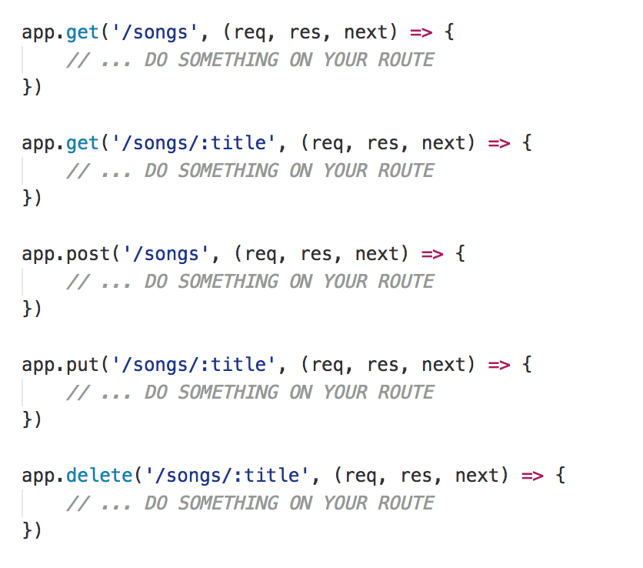
Routing
Routing refers to determining how an application responds to a client request to a particular endpoint, which is a URI (or path) and a specific HTTP request method

Slide 45

Validate your input
The fastest JSON Schema validator for Node.js and browser

Slide 46
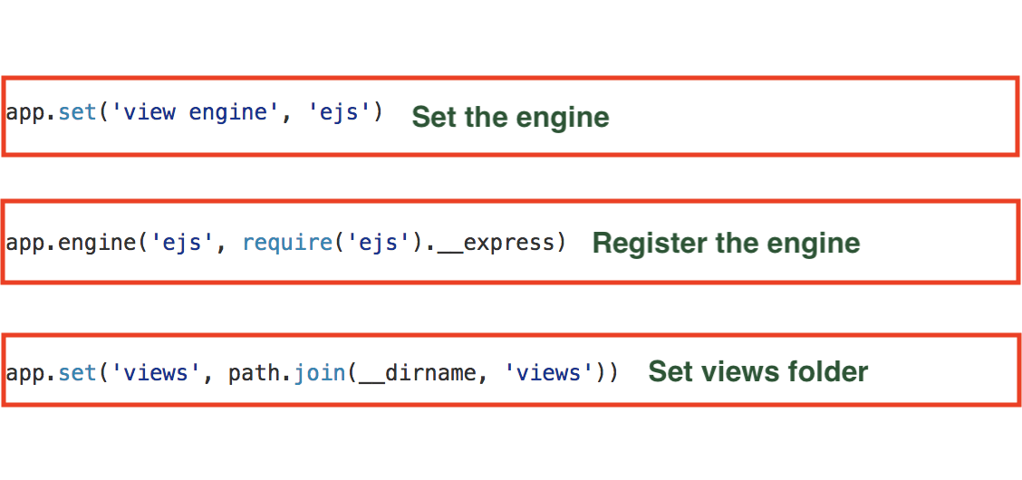
Views / template engine
Pug - Mustache - Dust - Nunjuks - EJS

Slide 47

Security
Helmet helps you secure your Express apps by setting various HTTP headers

Slide 48

Logger
Log everything that happens in your application
Pay attention there is a cost for logging
Winston

Slide 49
What is Node.js Native Add-on?
C / C++ code called from JavaScript
BRIDGE
Native environment
JavaScript
Notes:
In a very simple way Native Addons could be considered as C / C++ code called from JavaScript. They are a bridge between our Application programming language JavaScript and Native environment that is completely written in C / C++. This allow us to call C / C++ functions and methods directly from JavaScript.

Slide 50
From Node.js documentation
Node.js Addons are dynamically-linked shared objects, written in C++, that can be loaded into Node.js using the require() function, and used just as if they were an ordinary Node.js module.
They are used primarily to provide an interface between JavaScript running in Node.js and C/C++ libraries.
Notes:
If we take a look at Node.js documentation under Addons section Native Addons are defined as: dynamically-linked shared objects, written in C++, that can be loaded into Node.js using the require() function, and used just as if they were an ordinary Node.js module
Their main purpose is to provide an interface between JavaScript running in Node.js and C / C++ libraries.
This increase the developer experience because if you are using a Native Addon you don’t care of this, but you just use it as any other pure JavaScript module.

Slide 51
Why?
Performance
In general C / C++ code performs better than JavaScript code, but it’s not always true.
Image processing (in average 6 times faster)
Video processing
CRC cyclic redundancy check (in average 125 times faster)
Compression
Scientific calculus
Algorithms that execute CPU heavy tasks
Notes:
Why should you implement new Native Add-On?
The first reason is for performance
In general C / C++ code performs better then JavaScript code, but it’s really true for CPU bounds operations.
Think for example at:
Image processing | Video processing | Compression | Scientific calculus | Cyclic redundancy check and all algorithms that at one point execute some CPU heavy tasks.
In all these cases you can gain more in performance.

Slide 52
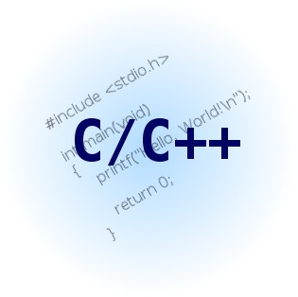
Why?
Integrate legacy application
You have the source code of an old C / C++ application and want to expose something of its functionalities
Notes:
Sometimes you want just integrate a legacy application
So you have the source code of an old C / C++ application and want to expose something of its functionalities through new Node.js application

Slide 53
Why?
You don’t find what fits your specific needs on npm
Sometimes completely implementing the module in JavaScript is not the right solution
Think at libraries like:
ImageMagick
Ghostscript
FFmpeg
TensorFlow
…
Notes:
Even if npm is a very large repo where you can find almost everything sometimes you don’t find what fits your specific needs and in this case you have to take a choice.
Completely reimplementing the module in JavaScript, but in my opinion it’s an insane idea to reimplement from the ground solutions like ImageMagick | Ghostscript | Ffmpeg and TensorFlow because you will lose all your time on develop a module and not to concentrate on business logic of your application. In these cases the
You have to concentrate on business logic of your application and not on developing a single module

Slide 54
Why?
Better error handling
Even if you will use an old C / C++ library you will get an error code that explains the error that just happened
In new C / C++ library you have the exception
You don’t have to parse some string to identify if there was an error and what kind of it

Slide 55

With great power comes great responsibility
Ben Parker

Slide 56
Problems
Fragmentation API
The API to implement native add-ons has been changed across different version of Node.js
Most of the changes were on V8 API and ObjectWrap API
0.8 - 0.10.x - 0.12.x - 1.x - 2.x - 3.x - 4.x - 5.x - 6.x - 7.x - 8.x - 9.x - 10.x - 11.x - 12.x
For more info http://v8docs.nodesource.com/

Slide 57
Problems
Need an adapter to stay compatible across different version of Node.js
NAN - Native Abstraction for Node.js
API compatibility
Strong bonded with V8 API
You have to recompile your native add-ons switching to different version of Node.js

Slide 58
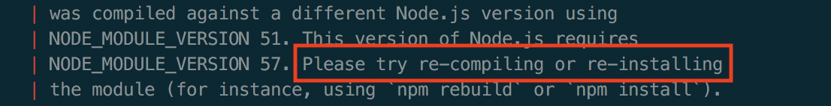
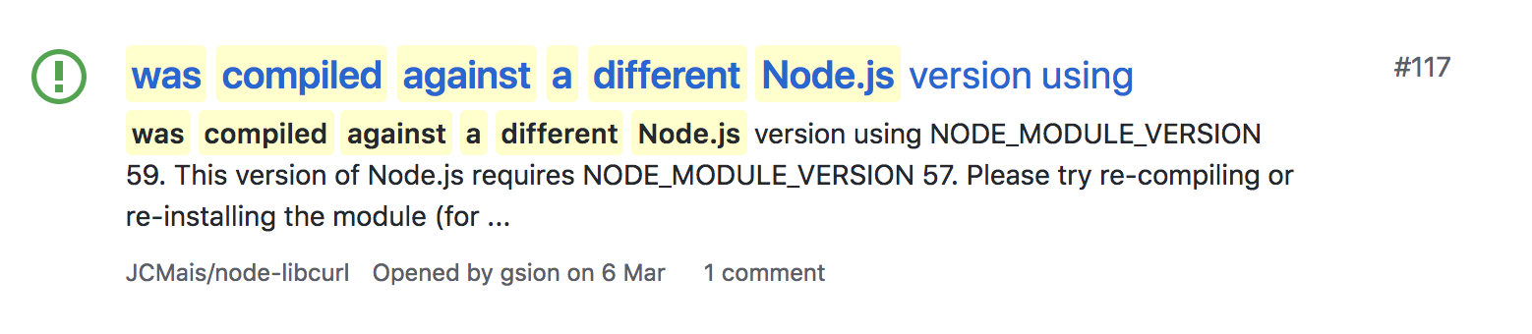
Problems
End user
Mantainers

Slide 59

Node.js: 6.12.2
V8: 5.1.281
NODE_MODULE_VERSION: 48
Addon

Slide 60

ABI break
At worst, mysterious segfaults
At best, addon fails to load
NODE_MODULE_VERSION mismatch
Node.js: 8.9.3
V8: 6.1.534
NODE_MODULE_VERSION: 57

Slide 61
Problems
Write portable C / C++ code
Your native code must compile and run on different:
ARCHITECTURE
PLATFORM
COMPILER

Slide 62
Problems
Documentation
C / C++ libraries that you are integrating are not well documented
There are good references but not so much practical guide focusing on complex concepts about native add-ons

Slide 63
N-API
N-API will be a game changer on the native add-on development
API and ABI compatibility
Isolated from V8 (VM agnostic)
New ES6 types
C / C++ (only header wrapper)
Conversion tool that helps to migrate from NAN
Generator (helps with initial scaffolding)
Pre-builds (node-pre-gyp - prebuild - prebuildify)
Notes:
N-API is one of the most important features announced with Node.js 8 which is aimed at reducing the maintenance cost for native add-ons

Slide 64
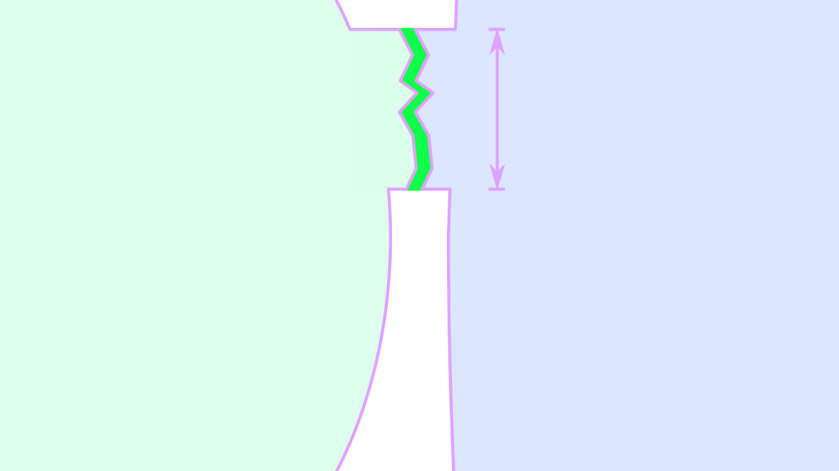
Node.js: no matter
V8/ChakraCore: no matter
NAPI_VERSION: 1
Notes:
N-API is one of the most important features announced with Node.js 8 which is aimed at reducing the maintenance cost for native add-ons

Slide 65
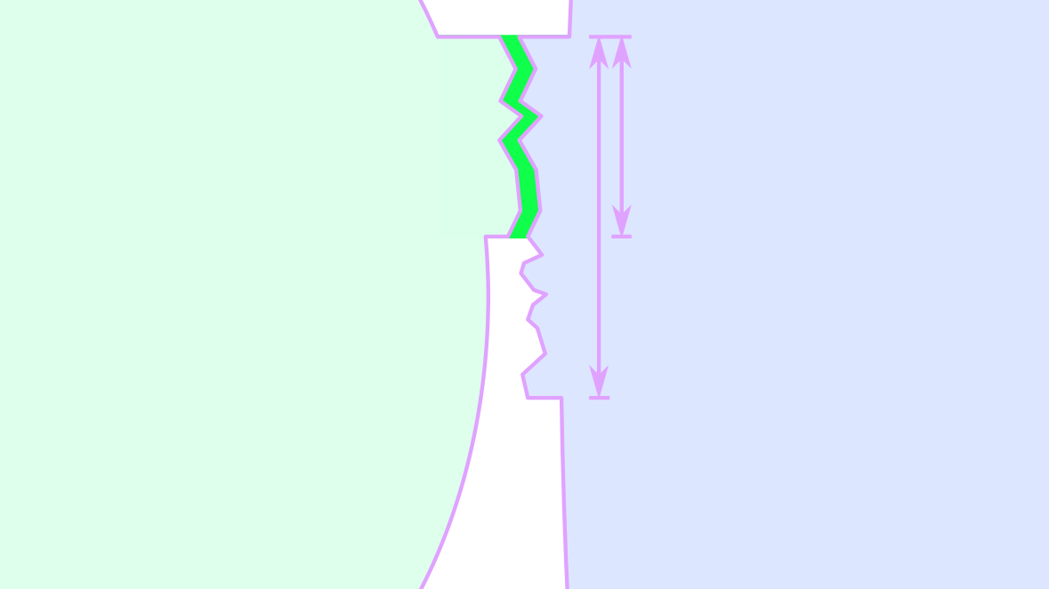
No ABI break
NAPI_VERSION is cumulative
Addon is forwards compatible
Node.js: later
V8/ChakraCore: no matter
NAPI_VERSION: 2
Notes:
N-API is one of the most important features announced with Node.js 8 which is aimed at reducing the maintenance cost for native add-ons

Slide 66
N-API
Kicked off in VM Summit April 2016
Dual implementation from the start (V8 / ChakraCore)
EPS Dec 2016 https://github.com/nodejs/node-eps/blob/master/005-ABI-Stable-Module-API.md
First half of 2017 - refinement and backporting module
May 2017 experimental release in Node.js 8
VM Summit July 2017 – Exit criteria agreed
N-API leaves experimental status March 14 2018
Backported to all LTS release
Improve core and C++ Wrapper (node-addon-api)
Create ecosystem
Notes:
N-API is one of the most important features announced with Node.js 8 which is aimed at reducing the maintenance cost for native add-ons

Slide 67
N-API
N-API is C whereas node-addon-api is C++
node-addon-api not thechnically part of ABI stable API
Helper to simplify code using C++
All inline
Only depends on export N-API C functions
Notes:
N-API is one of the most important features announced with Node.js 8 which is aimed at reducing the maintenance cost for native add-ons

Slide 68
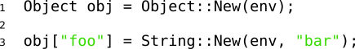
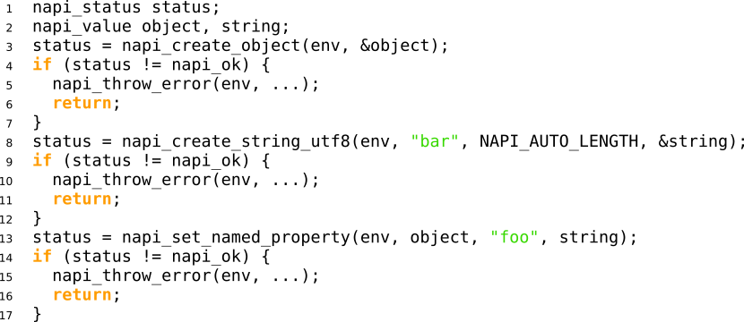
N-API and node-addon-api
Notes:
N-API is one of the most important features announced with Node.js 8 which is aimed at reducing the maintenance cost for native add-ons

Slide 69
node-addon-api vs NAN
Same
Includes C++ wrapper
Provides common helper functionality
Reduces likelihood of needing to change code for new Node.js versions
Different
Does not use V8 Types
Not tied to a specific JavaScript engine
Preserves compile once/ run multiple versions from N-API
Reduces even further likelihood of having to change code
Notes:
N-API is one of the most important features announced with Node.js 8 which is aimed at reducing the maintenance cost for native add-ons

Slide 70
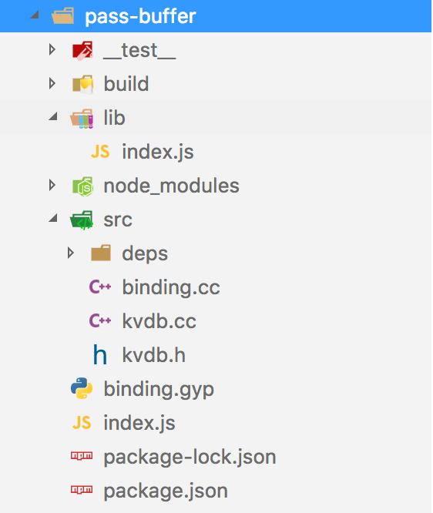
How to organize your project
Notes:
When I start to develop a new native addon I use the boilerplate depicted on the slide. Here the most important elements are the SRC and LIB folders.
SRC folder contains the C / C++ code and the native dependencies
while
the LIB folder contains the JavaScript code
There are also the usual package.json file and the binging.gyp file that contains all the building configurations for the addon.
At the end our addon will be composed by two parts one written in C++ and another written in JavaScript and usually the JavaScript part will use the
native code to expose some features

Slide 71
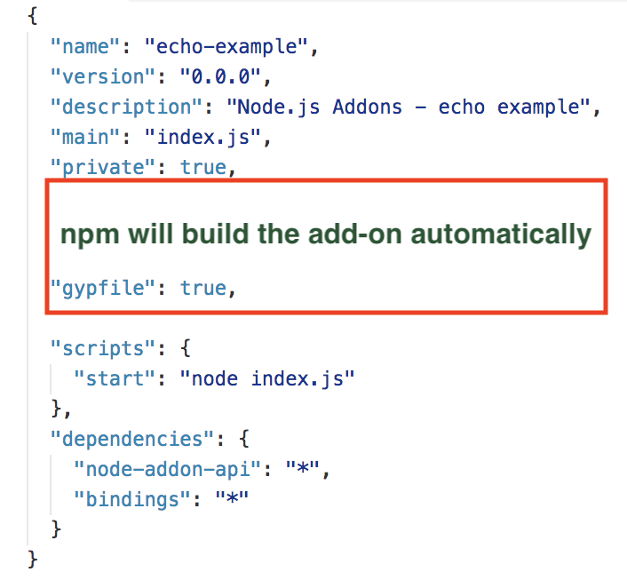
Example: the JavaScript part
Notes:
When I start to develop a new native addon I use the boilerplate depicted on the slide. Here the most important elements are the SRC and LIB folders.
SRC folder contains the C / C++ code and the native dependencies
while
the LIB folder contains the JavaScript code
There are also the usual package.json file and the binging.gyp file that contains all the building configurations for the addon.
At the end our addon will be composed by two parts one written in C++ and another written in JavaScript and usually the JavaScript part will use the
native code to expose some features

Slide 72
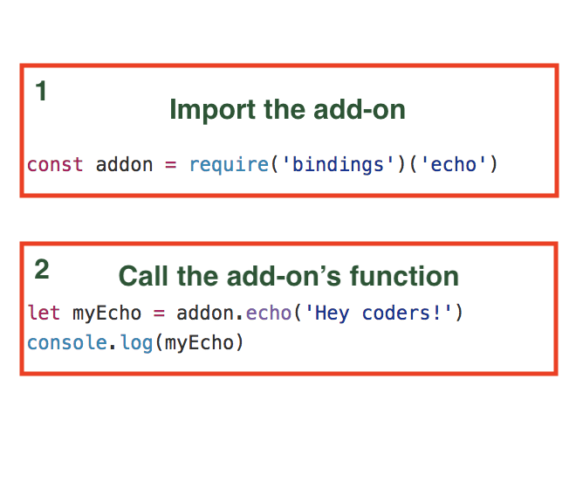
Example: the JavaScript part
Notes:
When I start to develop a new native addon I use the boilerplate depicted on the slide. Here the most important elements are the SRC and LIB folders.
SRC folder contains the C / C++ code and the native dependencies
while
the LIB folder contains the JavaScript code
There are also the usual package.json file and the binging.gyp file that contains all the building configurations for the addon.
At the end our addon will be composed by two parts one written in C++ and another written in JavaScript and usually the JavaScript part will use the
native code to expose some features

Slide 73
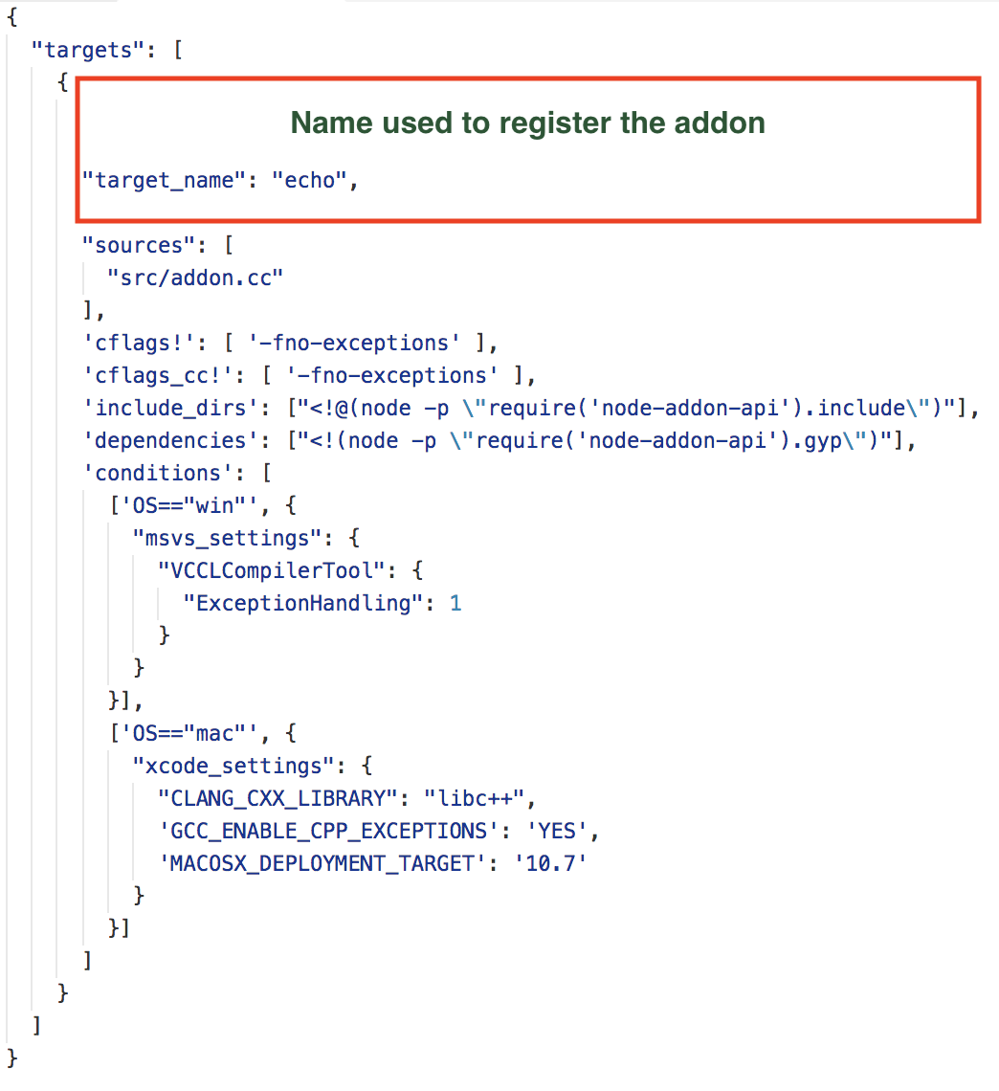
Example: the binding.gyp
Notes:
In our binding.gyp we need to set the target name that will match the module name. The reported example is almost simple sometimes finding the right settings for binding.gyp is not easy so I suggest to take a look at GYP documentation or at nodey-gyp wiki where there are examples of existing binding.gyp and use them as source of inspiration to solve your problems with these kind of configurations.

Slide 74
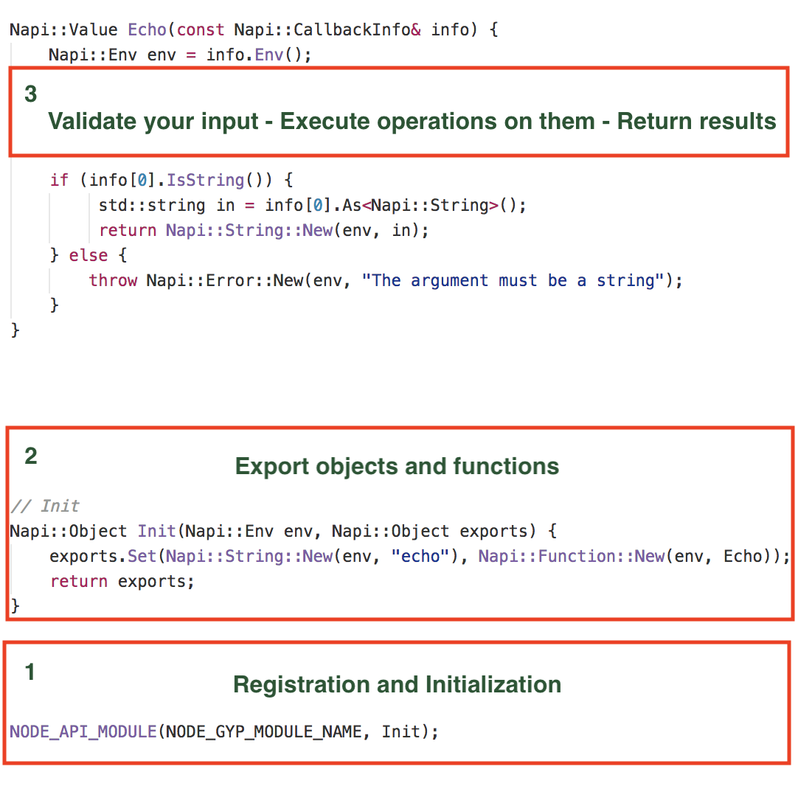
Example: the C / C++ part
Notes:
What happen here?
The macro NODE_API_MODULE creates code that will register a module named ”echo” and in addition it will ensure that a function init is called when the module is required.
In the init we export our function or object. In the reported example we export echo and you can find the code executed by this function in the method Echo.
As first thing we validate the input data, then transfer the JavaScript input to C++ data structure. C++ code perform the requested computation and before returning transfer the output data to JavaScript context.
This is the most straightforward integration pattern that you can realize to pass data between JavaScript and C / C++ . The main reason for using this approach is simplicity and because you can integrate the C++ without modification. In addition we have a complete decoupling of the JavaScript and C++ code.

Slide 75
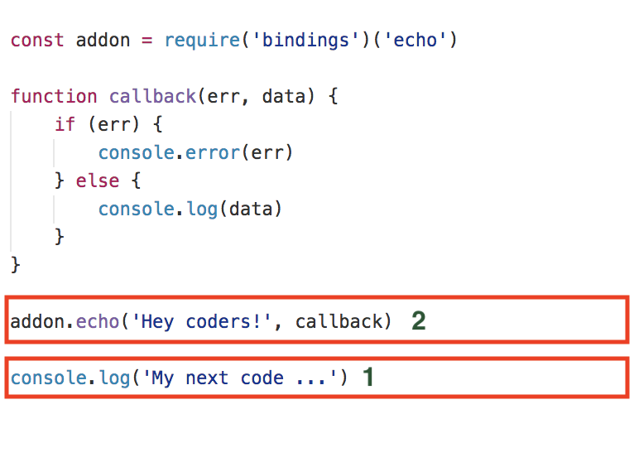
Asynchronous code

Slide 76
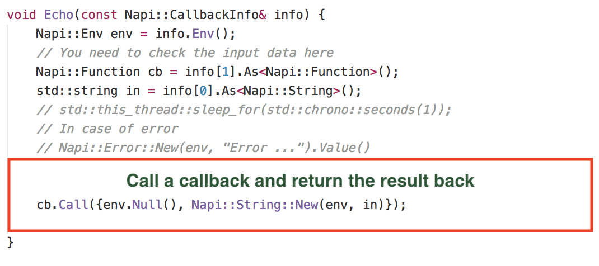
Asynchronous code
Notes:
In an asynchronous addon function, the calling JavaScript code returns immediately.
The calling code passes a callback function to the addon, and the addon does its work in a separate worker thread.
This avoids locking up the Node.js event loop, as the addon function does not block.

Slide 77
Asynchronous code
Preserve reference to function we want call
Create worker threads using libuv
Handle the results

Slide 78
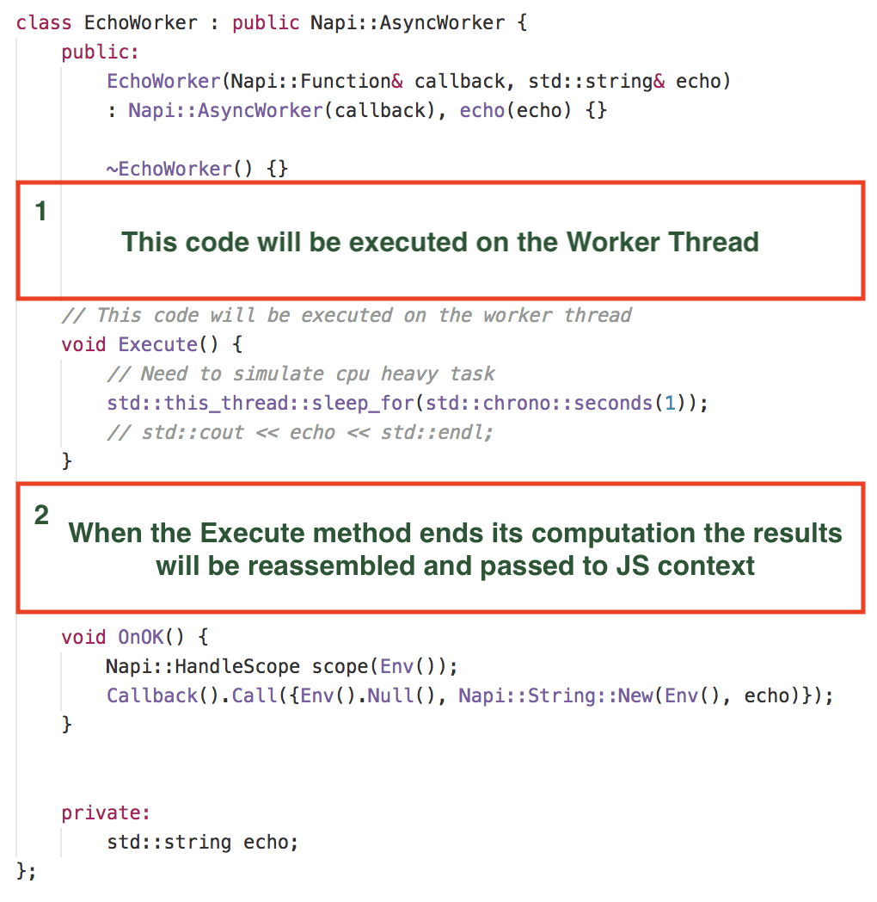
AsyncWorker

Slide 79
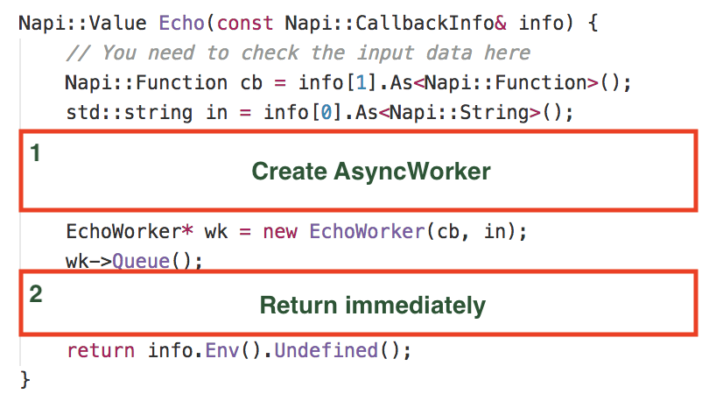
AsyncWorker

Slide 80
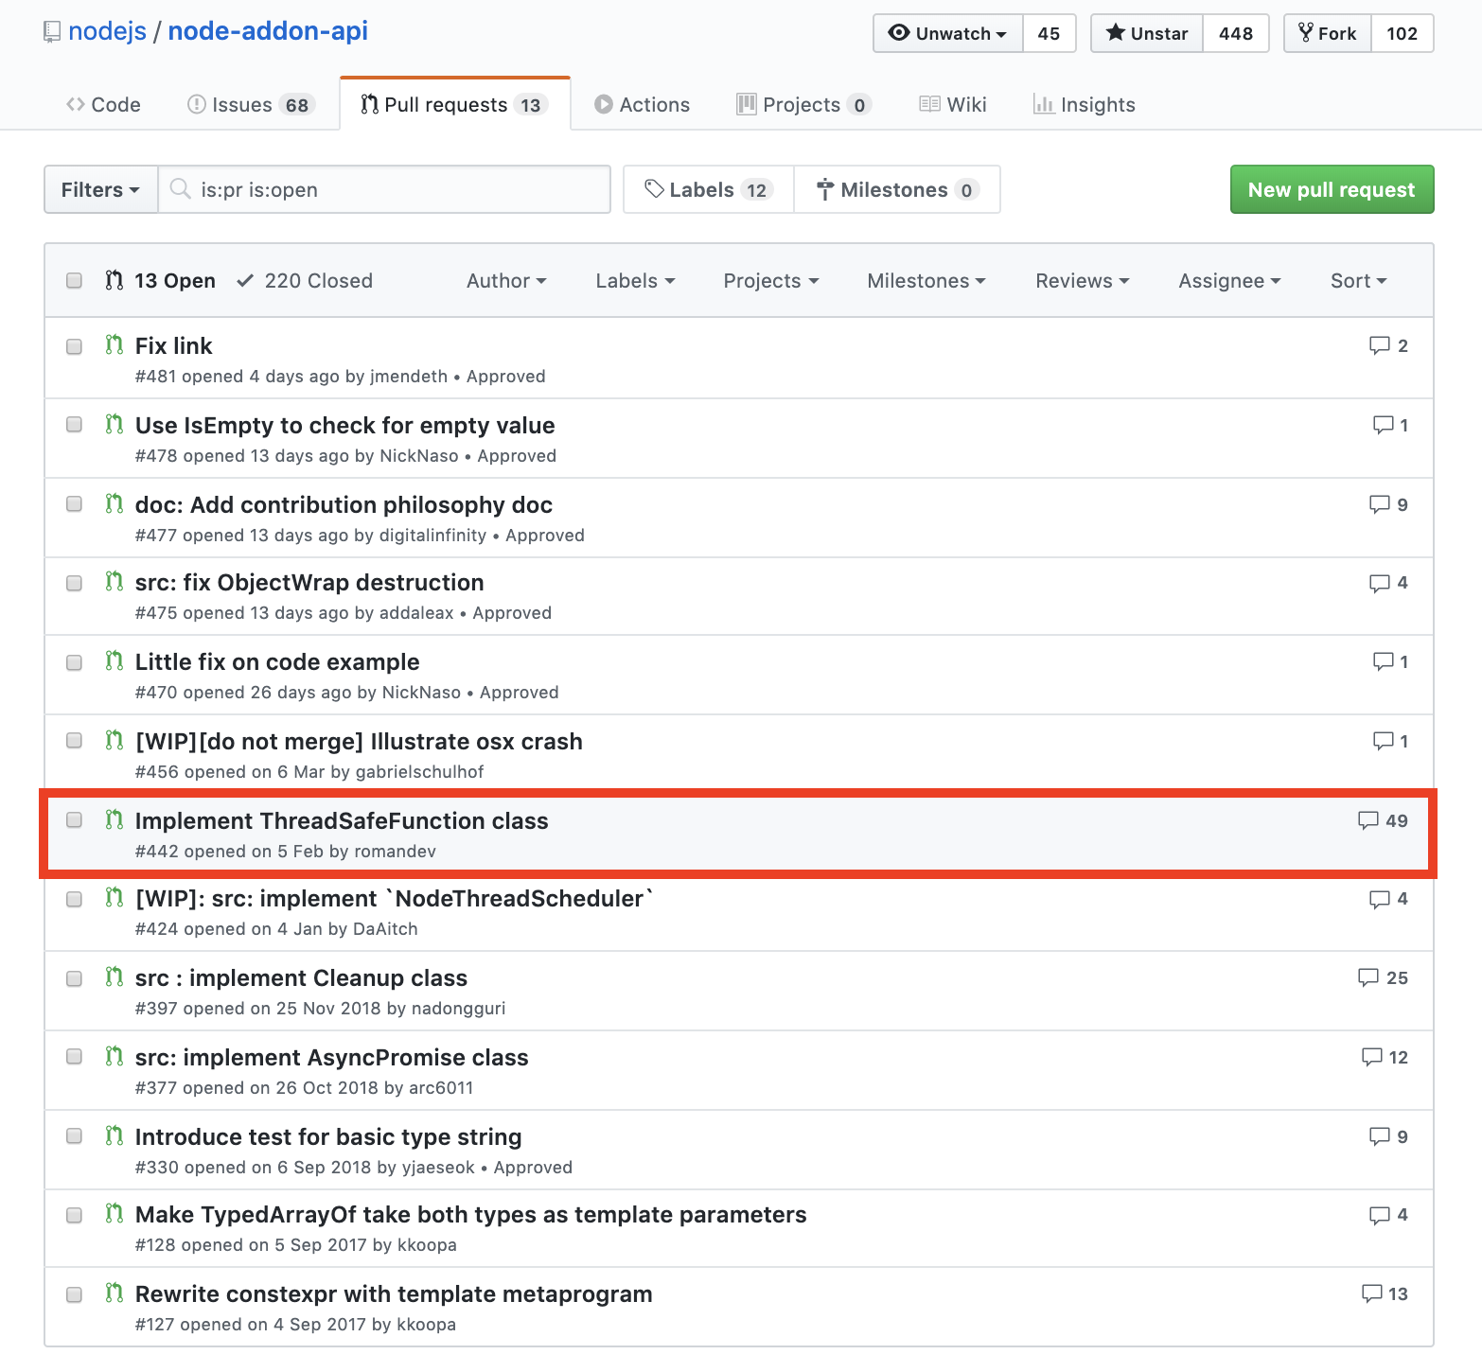
AsyncWorker
You cannot call JavaScript function from the Worker Thread until this PR will be landed

Slide 81
ObjectWrap API
ObjectWrap is a way to expose your C++ code to JavaScript
You have to extend ObjectWrap class that includes the plumbing to connect JavaScript code to a C++ object
Classes extending ObjectWrap can be instantiated from JavaScript using the new operator, and their methods can be directly invoked from JavaScript
Unfortunately, the wrap part really refers to a way to group methods and state
It’s your responsibility write custom code to bridge each of your C++ class methods.

Slide 82
Lessons learned
Create simple interface between C / C++ and JavaScript
Think carefully at JavaScript interface
Use ObjectWrap API to return C / C++ object to JavaScript
Validate the types on the native side
Expose only the functionalities you need
Don’t block the event loop, stay asynchronous: this is a must if you will use the add-ons in high performance services
Use Buffer to pass big quantity of data

Slide 83
Thanks
Don’t be afraid sometimes it’s a good thing dirty your hands with a little of C++

